Slide 1
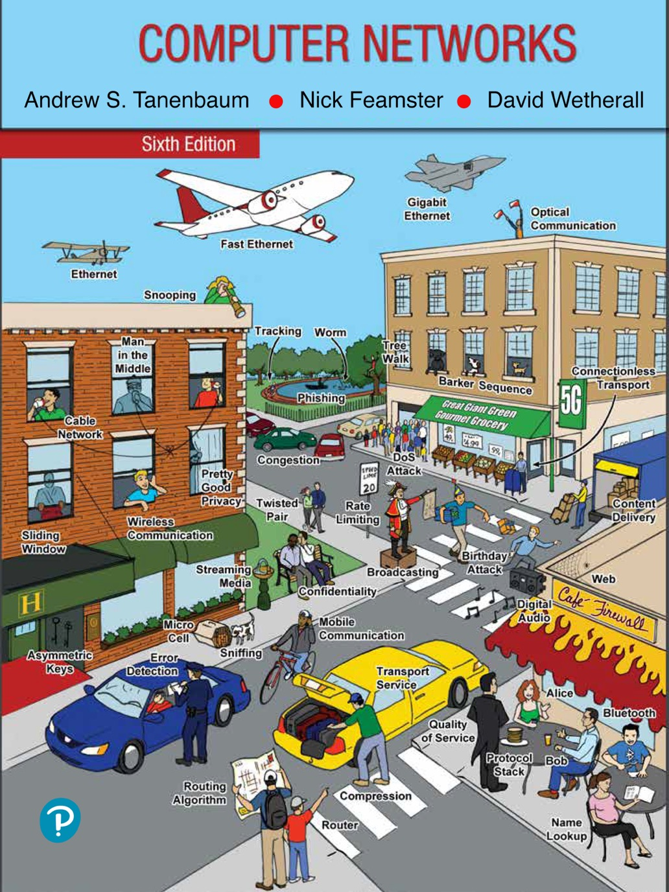
Chapter 8
Network Security

Slide 2
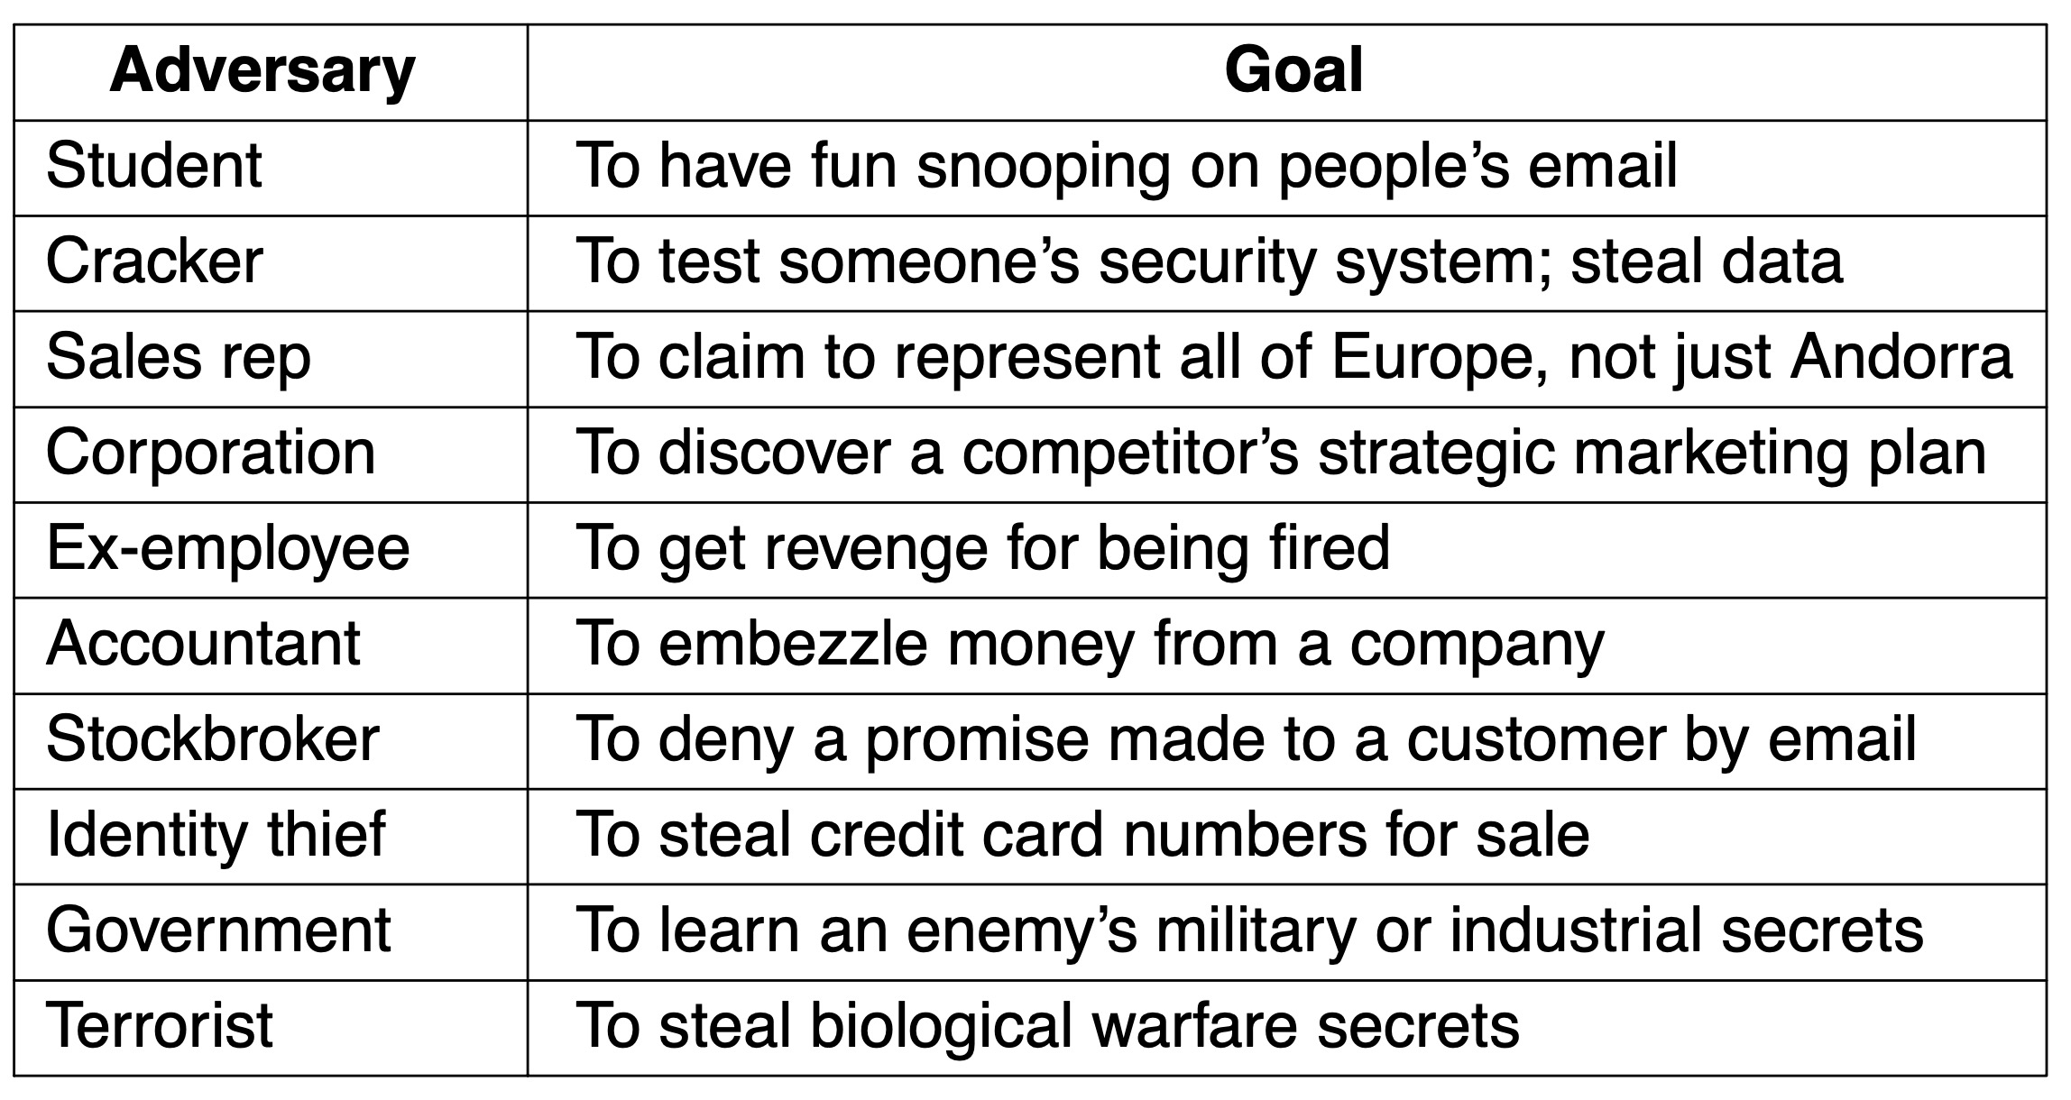
Network Security
Some people who may cause security problems, and why

Slide 3
Fundamentals of Network Security
Confidentiality
Keeping information away from unauthorized users
Integrity
Ensuring information received is what was really sent
Availability
Preventing systems and services from becoming unusable
Authentication
Deals with determining whom you are talking to before revealing sensitive information or entering into a business deal
Nonrepudiation deals with signatures

Slide 4
Fundamental Security Principles
Principle of economy of mechanism
Principle of fail-safe defaults
Principle of complete mediation
Principle of least authority
Principle of privilege separation
Principle of least common mechanism
Principle of open design
Principle of psychological acceptability

Slide 5
Fundamental Attack Principles
Attacker perspective on system security
Set of challenges to solve in order to reach their objectives
Multiple ways to violate confidentiality, integrity, availability
Steps and approaches attackers may use
Reconnaissance
Sniffing and snooping
Spoofing
Disruption (DoS [Denial of Service] attacks)

Slide 6
From Threats to Solutions
Determining what to do about attackers’ moves
Monitor the network
Address the systems-related issues of data confidentiality
Consider symmetric and public key cryptography
Consider digital signatures and key management
Look at the fundamental problem of secure authentication
Review network technologies providing communication security
Understand the problem of email security
Review security in the wider Web domain
Understand social issues regarding security

Slide 7
The Core Ingredients of an Attack
Reconnaissance
Sniffing and snooping (with a dash of spoofing)
Spoofing (beyond ARP)
Disruption

Slide 8
Reconnaissance (1 of 2)
Gain information about an organization
Dumpster dive or shoulder surf if physically possible
Use social engineering
Use the Internet to explore servers using IP addresses
Port scanning
Probe a machine for active port
Traceroute
Program that finds the path toward original IP addresses

Slide 9
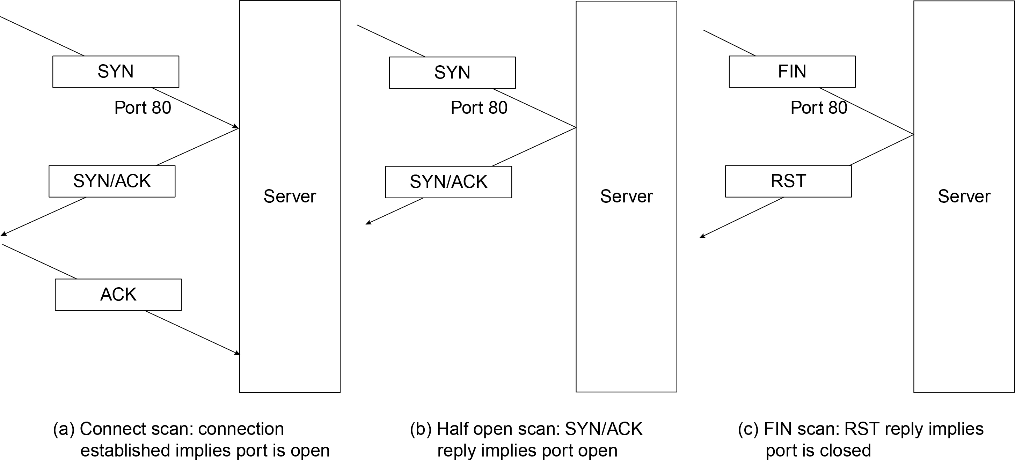
Reconnaissance (2 of 2)
Basic port scanning techniques. (a) Connect scan. (b) Half-open scan. (c) FIN scan.

Slide 10
Sniffing and Snooping (with a Dash of Spoofing)
Promiscuous mode accepts all packets on a channel
tcpdump or Wireshark captures the traffic
Sniffing in switched networks
Problem: Self-learning Ethernet switches
Overcome switching problem by spoofing
Attackers use MAC cloning to duplicate the MAC address of the host whose traffic is being sniffed
Attackers use MAC flooding
Attackers target hosts directly using an ARP spoofing or ARP poisoning attack
Attackers use an MITM (Man-in-the-Middle) gateway

Slide 11
Spoofing (Beyond ARP) (1 of 5)
SMTP Mail From: header
DNS spoofing
Birthday attack
Kaminsky attack
TCP spoofing
Connection spoofing
Connection hijacking
TCP connection hijacking
Off-path TCP exploits

Slide 12
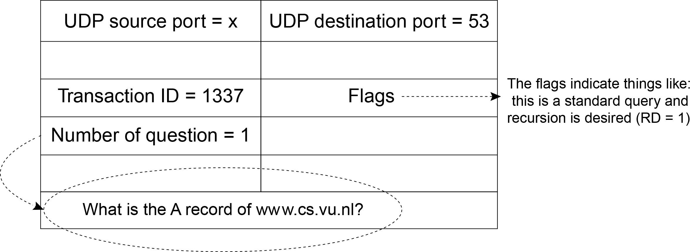
Spoofing (Beyond ARP) (2 of 5)
A DNS request for www.cs.vu.nl

Slide 13
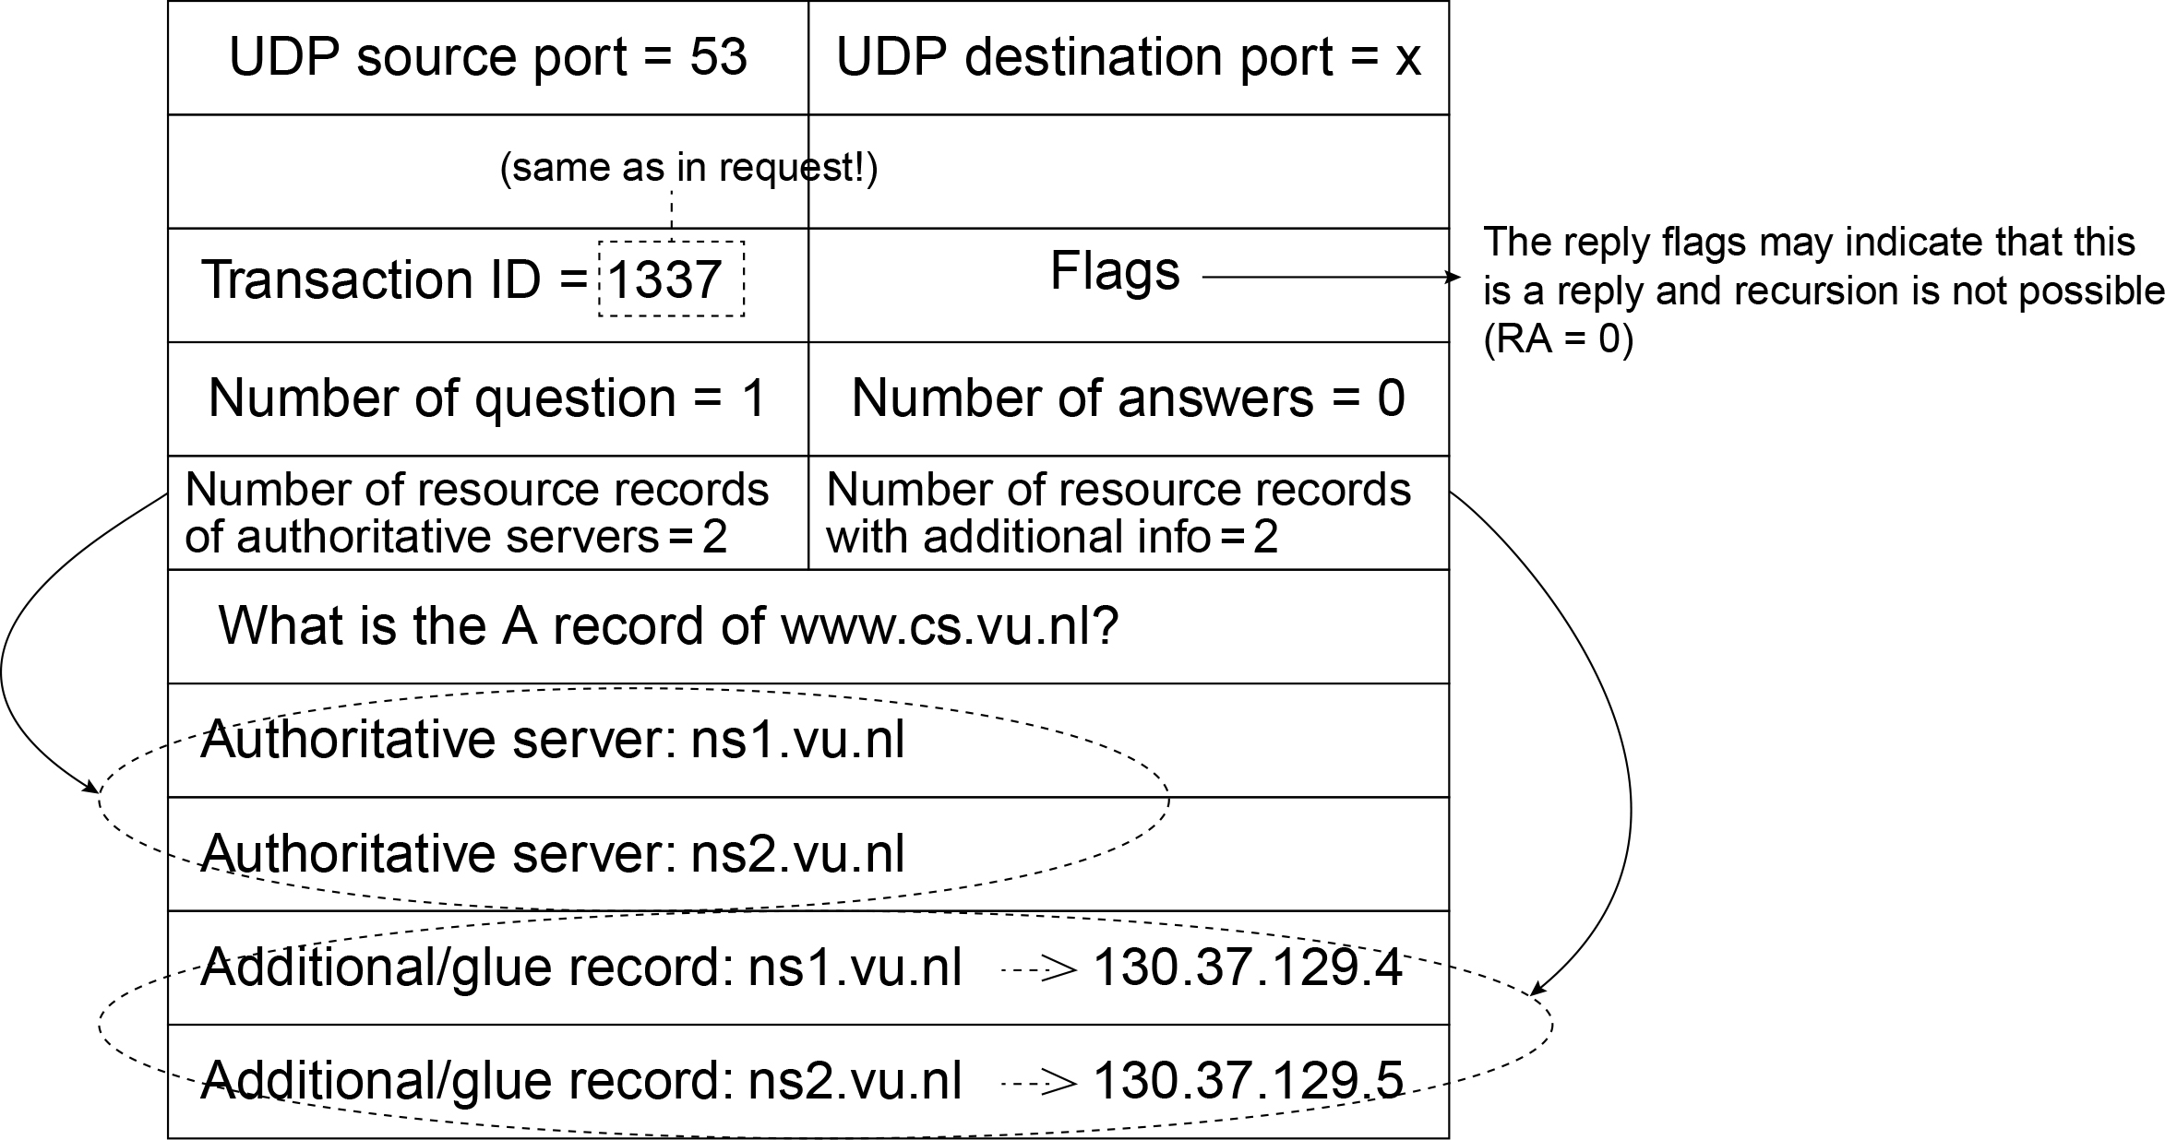
Spoofing (Beyond ARP) (3 of 5)
A DNS reply sent by the TLD name server

Slide 14
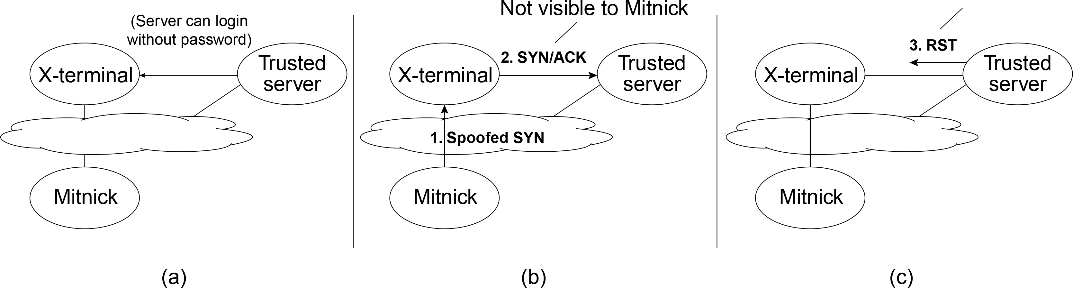
Spoofing (Beyond ARP) (4 of 5)
Challenges faced by Kevin Mitnick during the attack on SDSC

Slide 15
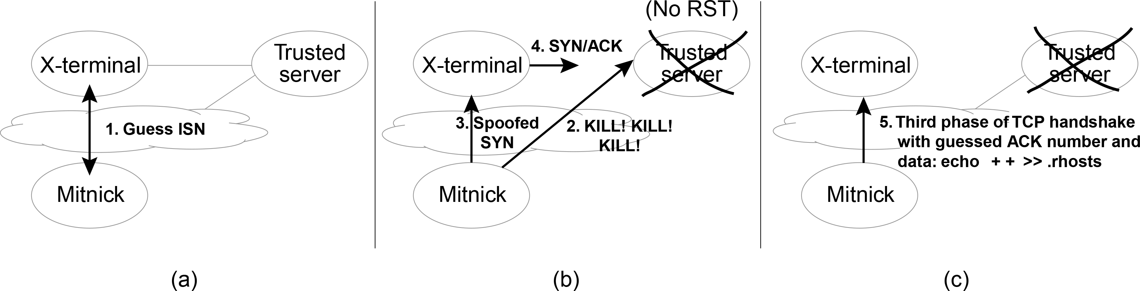
Spoofing (Beyond ARP) (5 of 5)
Mitnick’s attack

Slide 16
Disruption (1 of 2)
Denial-of-service attacks
Attacks on availability
Occur when a victim receives data it cannot handle
Reasons why a machine may stop responding:
Crashes
Algorithmic complexity
Flooding/swamping
SYN flooding
Reflection and amplification in DDoS attacks
Defending against DDoS attacks

Slide 17
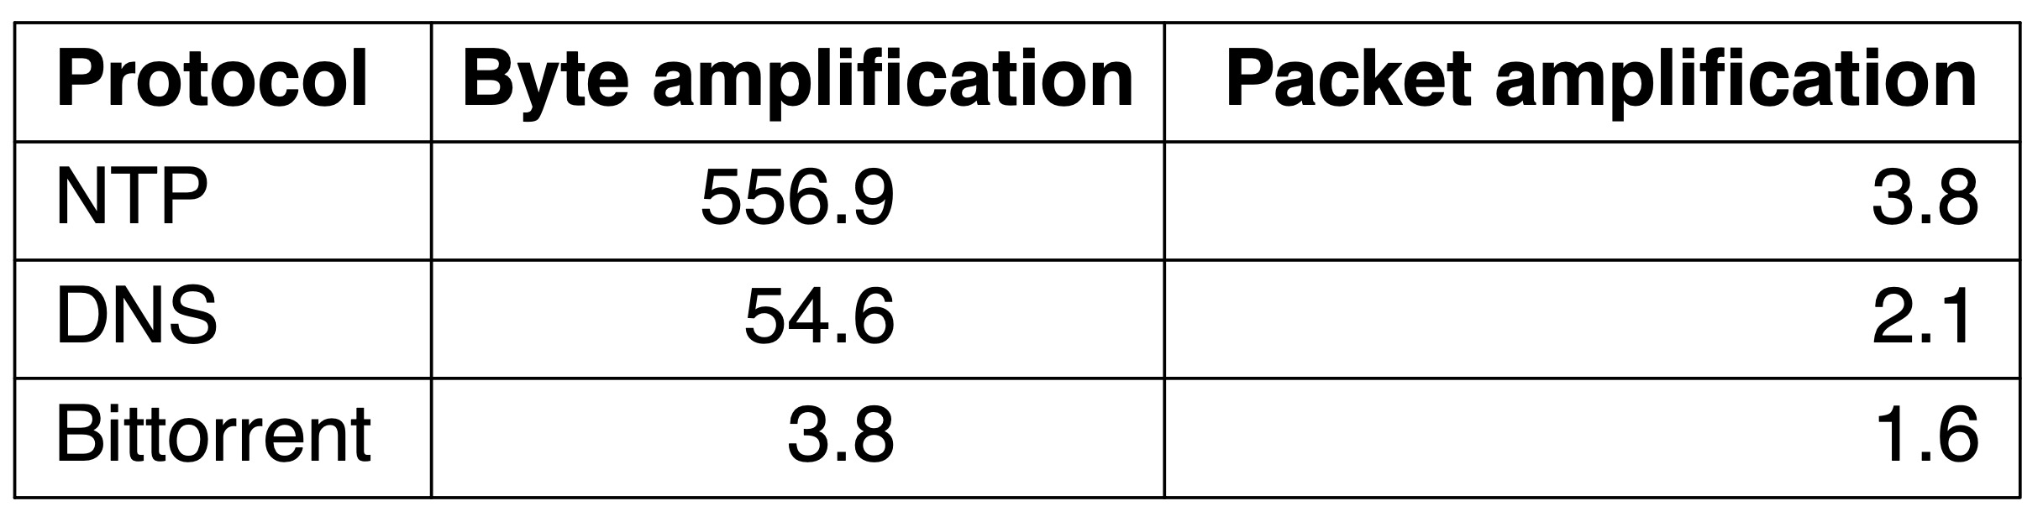
Disruption (2 of 2)
Amplification factors for popular protocols

Slide 18
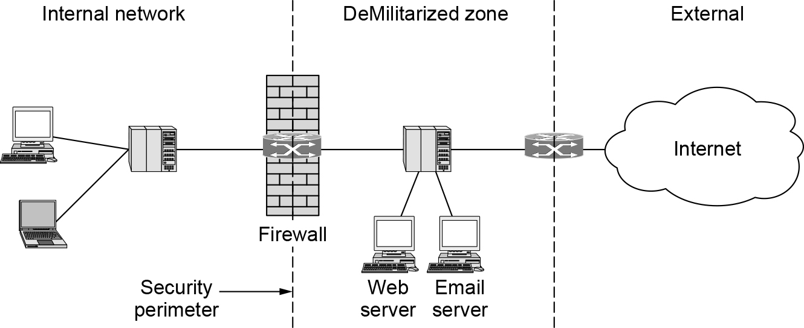
Firewalls
A firewall protecting an internal network

Slide 19
Intrusion Detection and Prevention
IDS (Intrusion Detection System)
Detect attacks—ideally before they can do damage
HIDS (Host-based IDS)
NIDS (Network IDS)
Signature-based intrusion detection systems
Anomaly-based intrusion detection systems
IPS (Intrusion Prevention System)
Should detect and stop an attack
Glorified firewall
Watch for false positives and false negatives
Principle of defense in depth

Slide 20
Cryptography
Introduction to cryptography
Two fundamental cryptographic principles
Substitution ciphers
Transposition ciphers
One-time pads

Slide 21
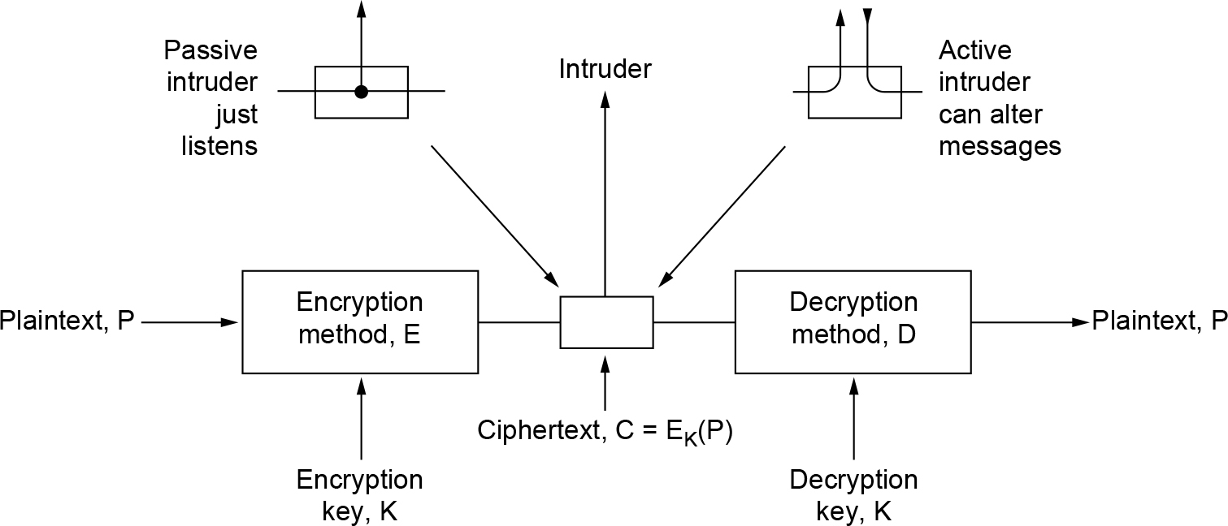
Introduction to Cryptography
The encryption model (for a symmetric-key cipher)

Slide 22
Two Fundamental Cryptographic Principles
Redundancy
Messages must contain some redundancy
Freshness
Some method is needed to foil replay attacks

Slide 23
Substitution Ciphers
Each letter or group of letters is replaced by another letter or group of letters to disguise it
Caesar cipher and monoalphabetic substitution cipher
Basic attack exploits natural language statistics
e is the most common letter, followed by t, o, a, n, i, etc.
th, in, er, re, and an are common two-letter combinations
the, ing, and, and ion are common three-letter combinations
Breaking a monoalphabetic cipher
Start by counting the relative frequencies of all letters in the ciphertext or guess a probable word or phrase

Slide 24
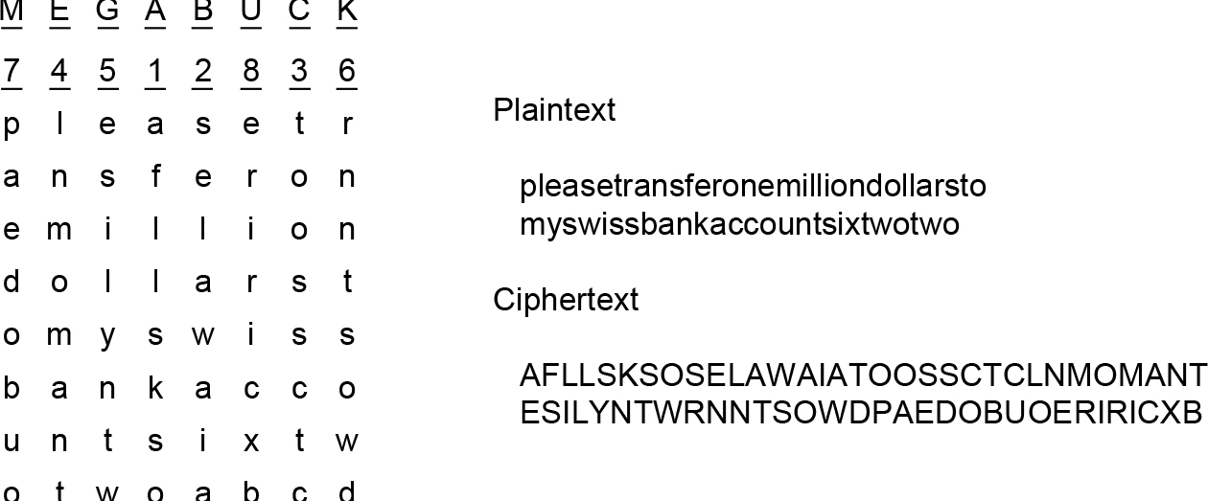
Transposition Ciphers
A transposition cipher

Slide 25
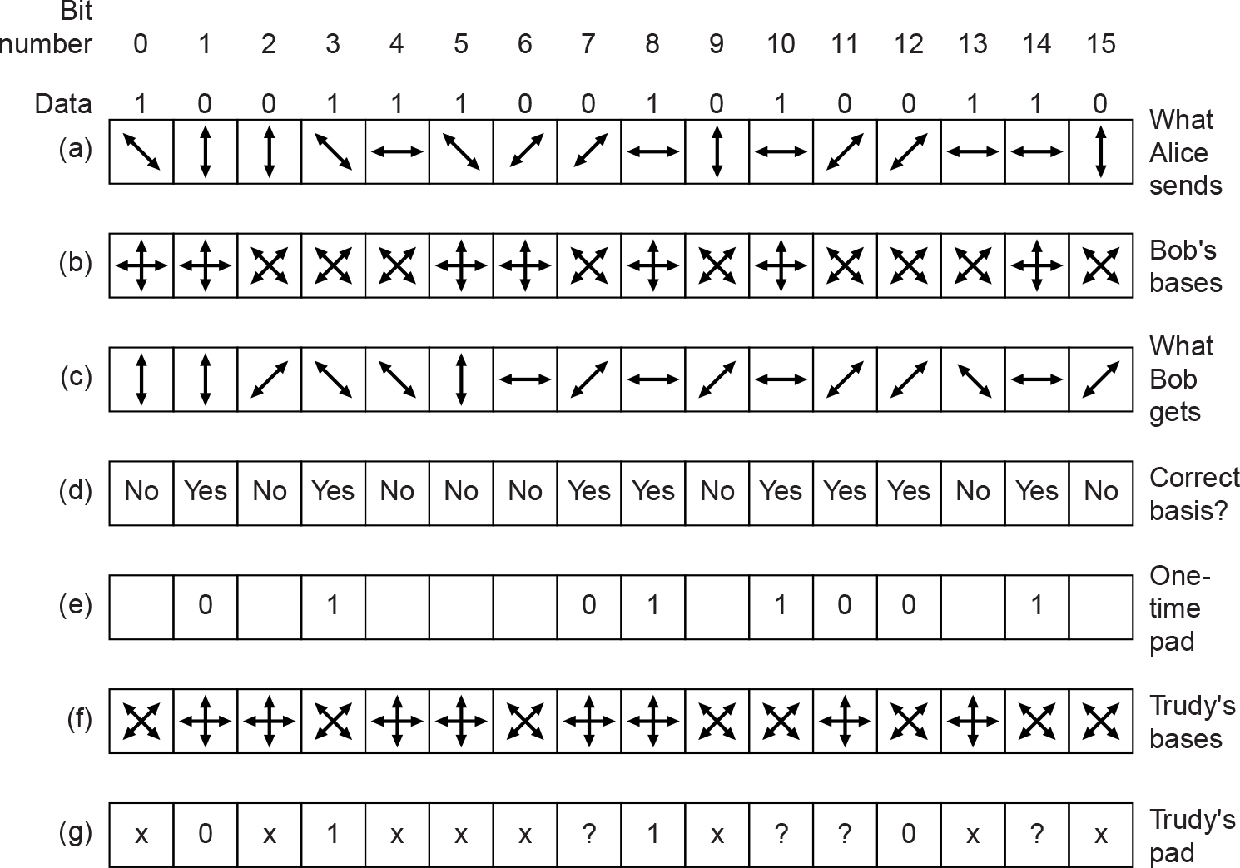
One-Time Pads (2 of 2)
An example of quantum cryptography

Slide 26
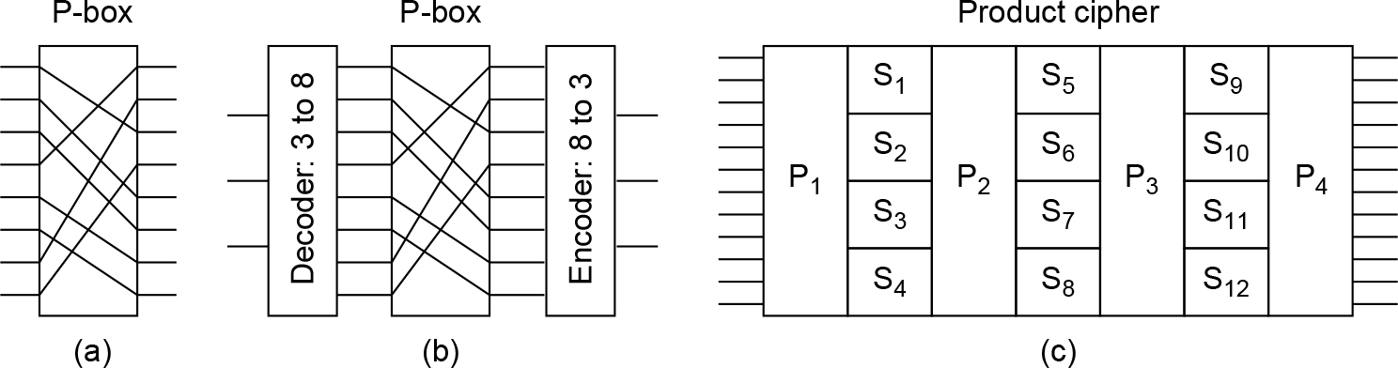
Symmetric-Key Algorithms (1 of 2)
Basic elements of product ciphers. (a) P-box. (b) S-box. (c) Product.

Slide 27
Symmetric-Key Algorithms (2 of 2)
The Data Encryption Standard
The Advanced Encryption Standard
Cipher modes

Slide 28
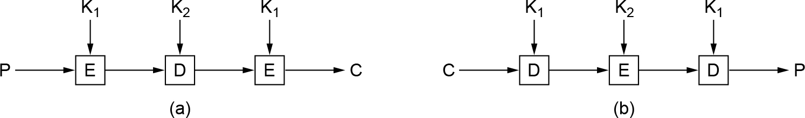
The Data Encryption Standard
(a) Triple encryption using DES. (b) Decryption.

Slide 29
The Advanced Encryption Standard (1 of 2)
The algorithm must be a symmetric block cipher
The full design must be public
Key lengths of 128, 192, and 256 bits must be supported
Both software and hardware implementations must be possible
The algorithm must be public or licensed on nondiscriminatory terms

Slide 30
The Advanced Encryption Standard (2 of 2)
Rijndael
Uses both substitution and permutations and multiple rounds
The number of rounds depends on the key size and block size, being 10 for 128-bit keys with 128-bit blocks and moving up to 14 for the largest key or the largest block
All operations involve an integral number of bytes (unlike DES)
Allows for efficient implementations in both hardware and software
Designed for great security and great speed

Slide 31
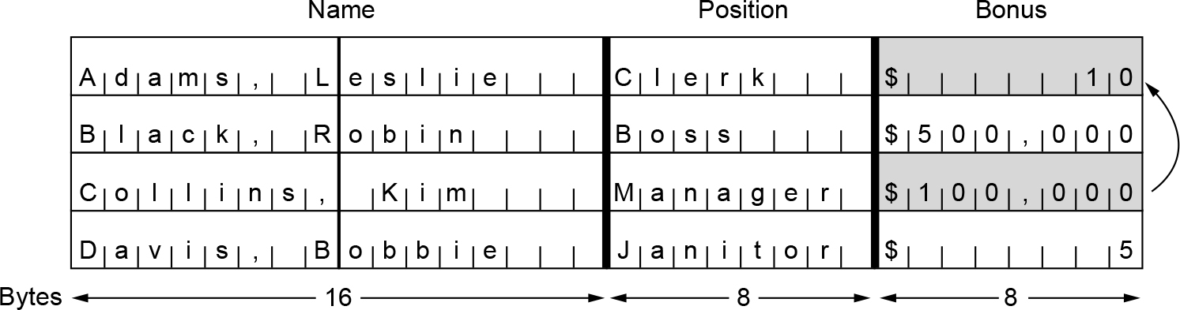
Cipher Modes (1 of 4)
The plaintext of a file encrypted as 16 DES blocks

Slide 32
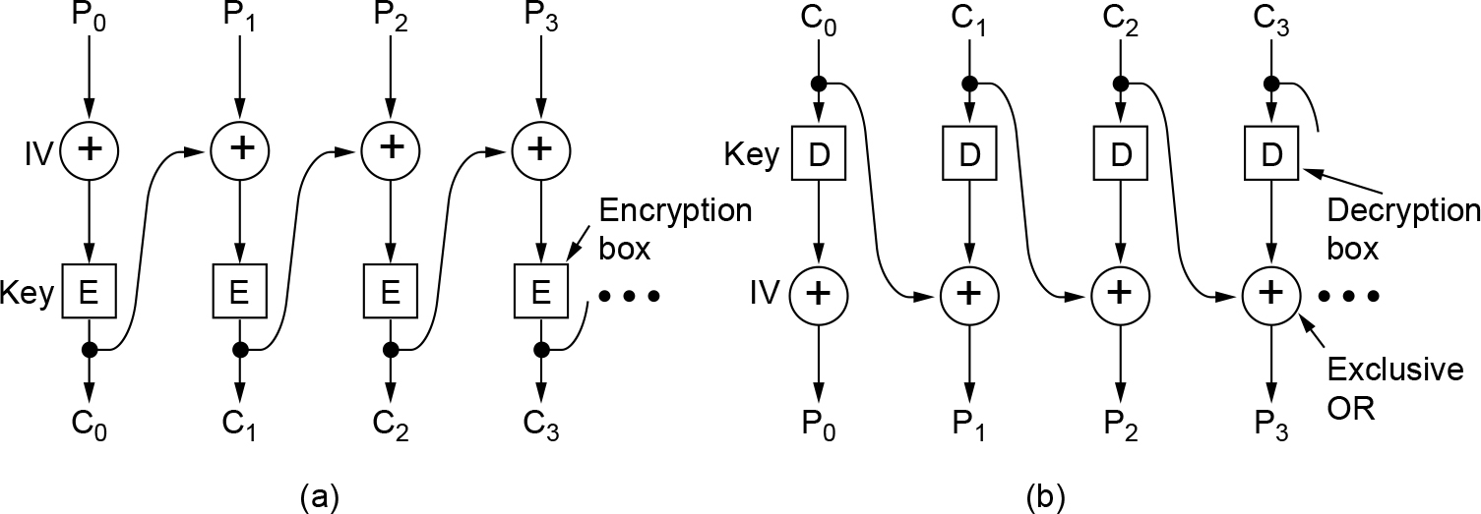
Cipher Modes (2 of 4)
Cipher block chaining. (a) Encryption. (b) Decryption.

Slide 33
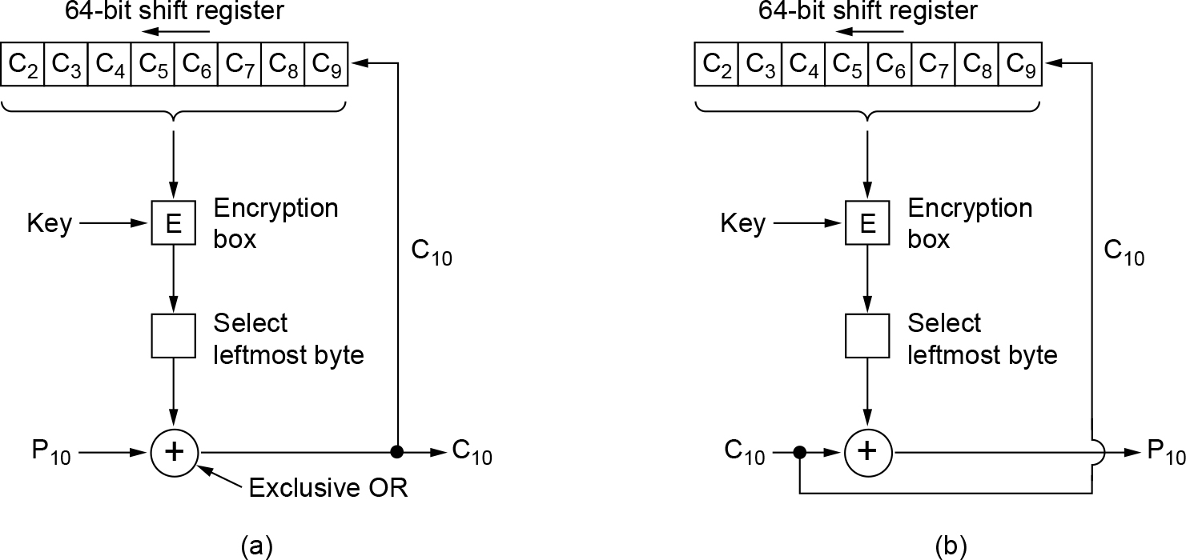
Cipher Modes (3 of 4)
Cipher feedback mode. (a) Encryption. (b) Decryption.

Slide 34
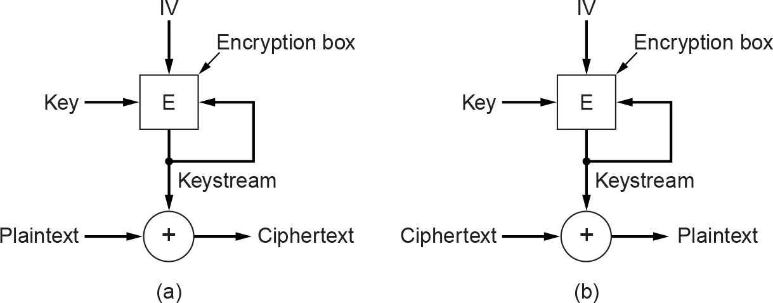
Cipher Modes (4 of 4)
A stream cipher. (a) Encryption. (b) Decryption.

Slide 35
Public-Key Algorithms
RSA
Authors: Rivest, Shamir, Adleman
Other public-key algorithms

Slide 36
RSA (1 of 2)
Method summary
Choose two large primes, p and q (say, 1024 bits)
Compute n = p × q and z = (p - 1) × (q - 1)
Choose a number relatively prime to z and call it d
Find e such that e × d = 1 mod z

Slide 37
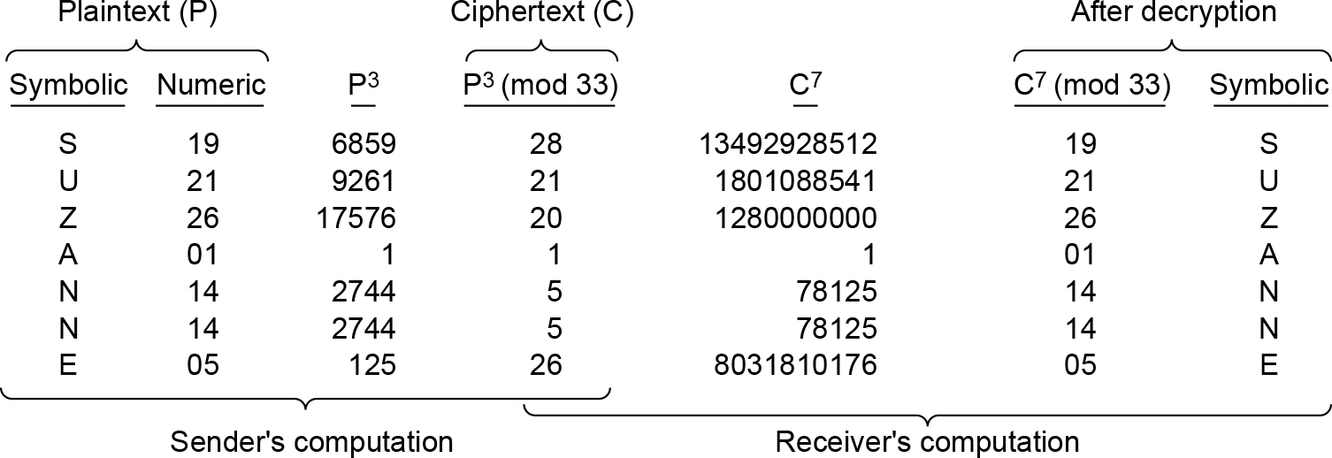
RSA (2 of 2)
An example of the RSA algorithm.

Slide 38
Other Public-Key Algorithms
Knapsack algorithm
First public-key algorithm
Ralph Merkel offered $100 if first version broken
Then offered $1000 if second version broken
Third version created with no reward offered
Not considered to be secure and not used in practice any more
Algorithms based on the difficulty of computing discrete logarithms or on elliptic curves
Algorithms based on the difficulty of factoring large numbers, computing discrete logarithms modulo a large prime, and elliptic curves

Slide 39
Digital Signatures (1 of 2)
Required conditions
The receiver can verify the claimed identity of the sender
The sender cannot later repudiate the contents of the message
The receiver cannot possibly have concocted the message himself

Slide 40
Digital Signatures (2 of 2)
Symmetric-key signatures
Public-key signatures
Message digests
The birthday attack

Slide 41
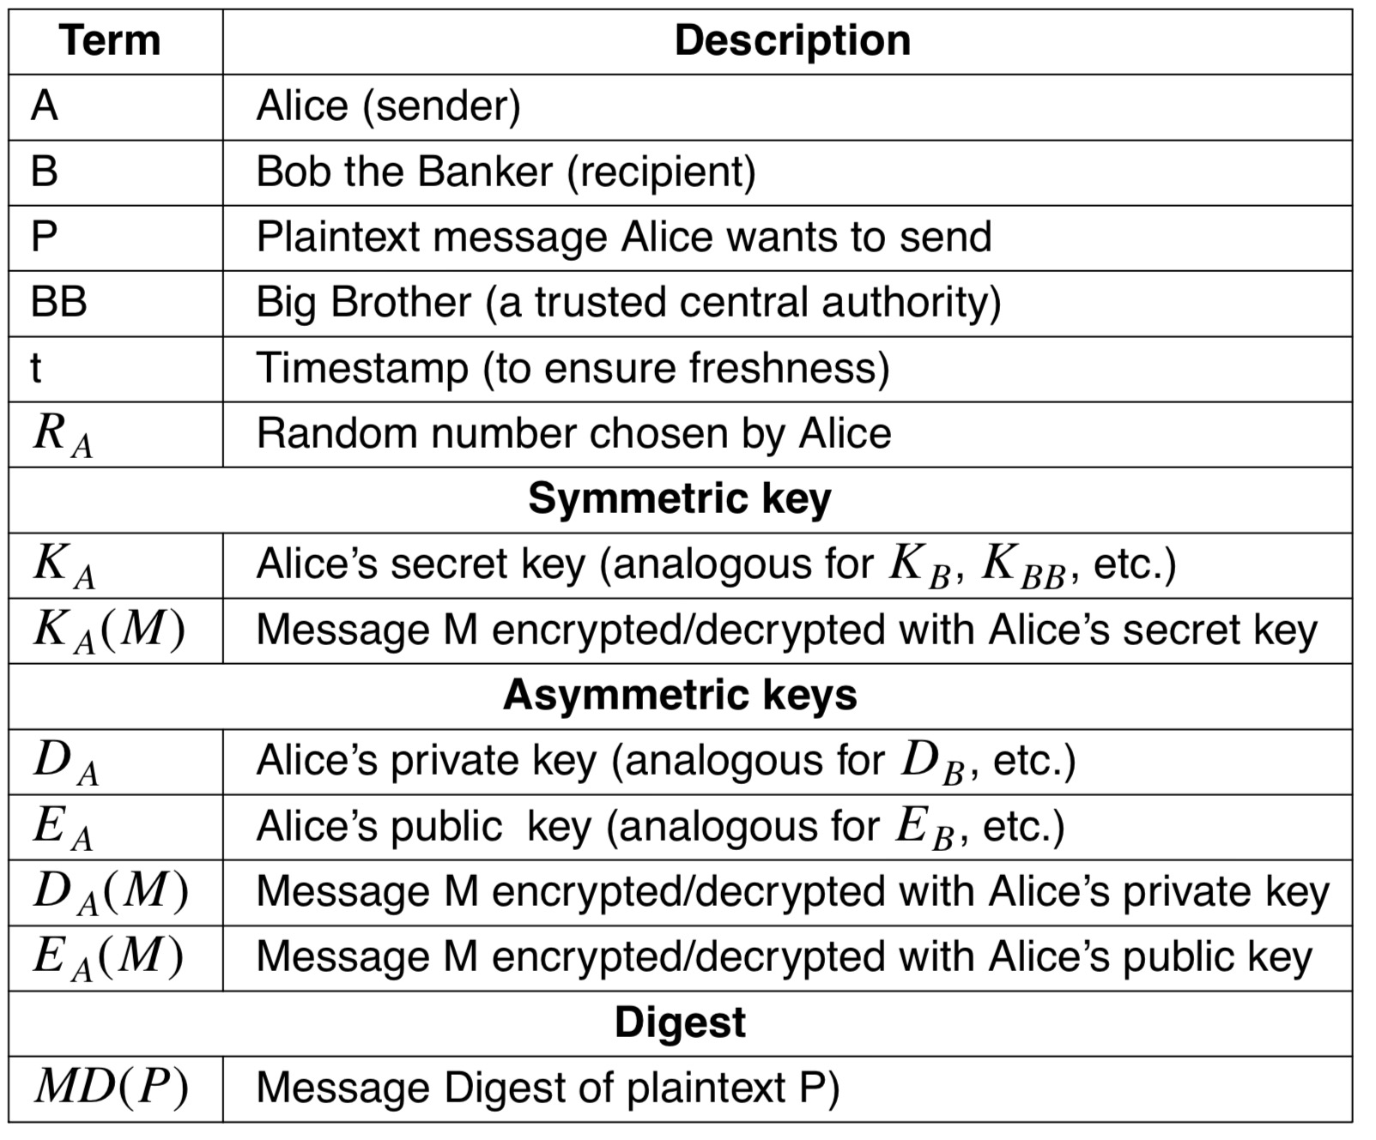
Symmetric-Key Signatures (1 of 2)
Alice wants to send a message to her banker: a legend to keys and symbols

Slide 42
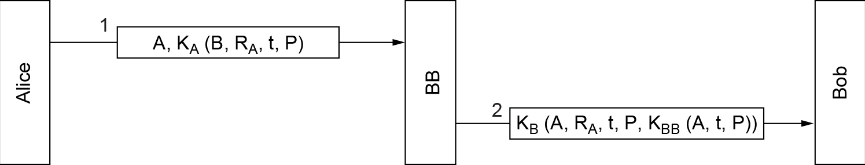
Symmetric-Key Signatures (2 of 2)
Digital signatures with Big Brother

Slide 43
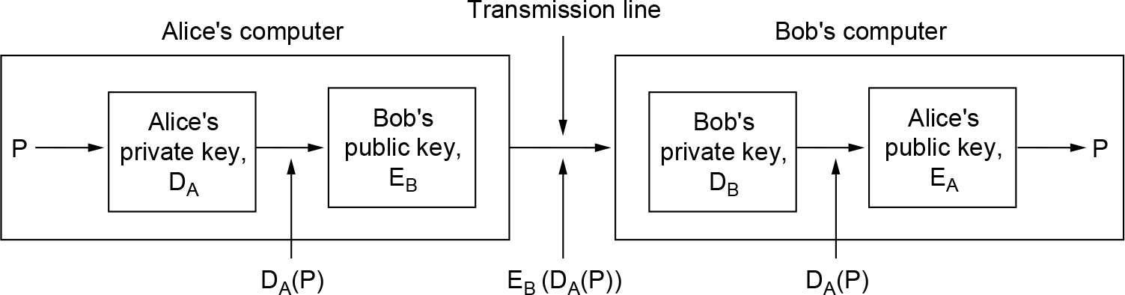
Public-Key Signatures (1 of 2)
Digital signatures using public-key cryptography

Slide 44
Public-Key Signatures (2 of 2)
DSS criticisms
Too secret (NSA designed the protocol for using El Gamal)
Too slow (10 to 40 times slower than RSA for checking signatures)
Too new (El Gamal had not yet been thoroughly analyzed)
Too insecure (fixed 512-bit key)

Slide 45
Message Digests (1 of 3)
Message digest properties
Given P, it is easy to compute MD(P)
Given MD(P), it is effectively impossible to find P
Given P, no one can find P^{v} such that MD(P^{v}) = MD(P)
A change to the input of even 1 bit produces a very different output

Slide 46
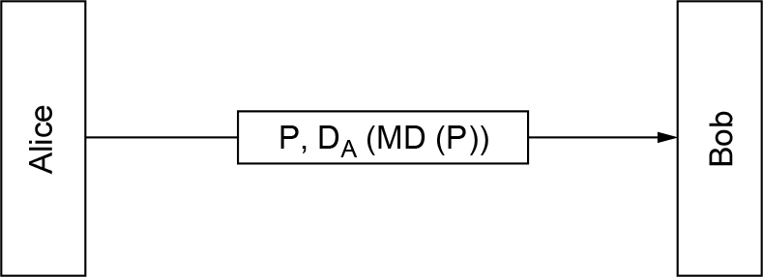
Message Digests (2 of 3)
Digital signatures using message digests

Slide 47
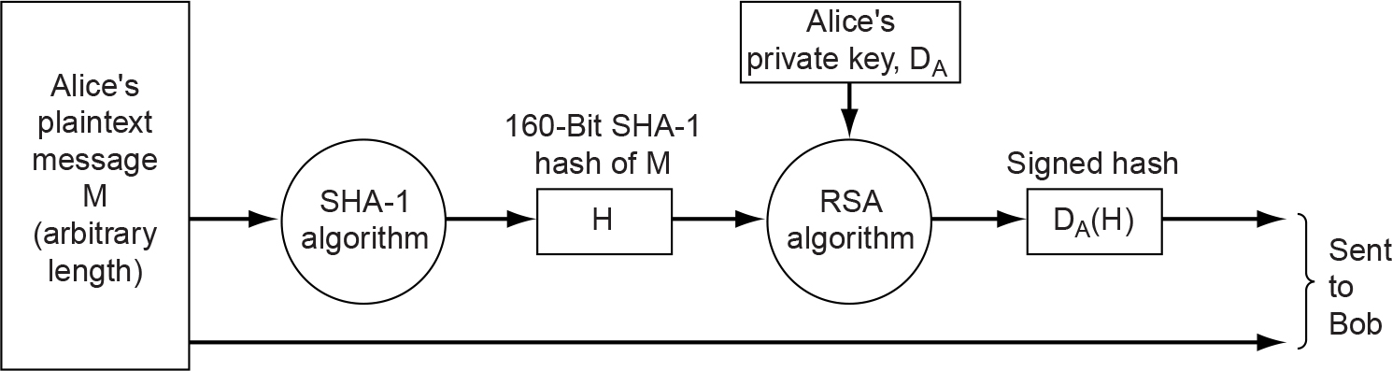
Message Digests (3 of 3)
Use of SHA-1 and RSA for signing nonsecret messages

Slide 48
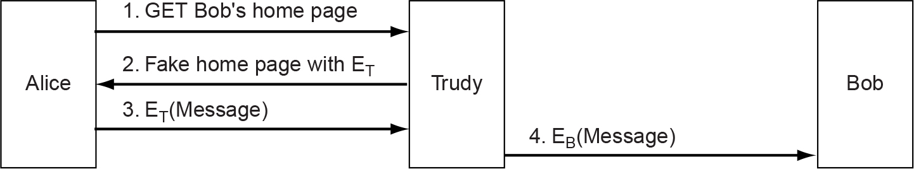
Management of Public Keys (1 of 2)
A way for Trudy to subvert public-key encryption

Slide 49
Management of Public Keys (2 of 2)
Certificates
X.509
Public key infrastructures

Slide 50
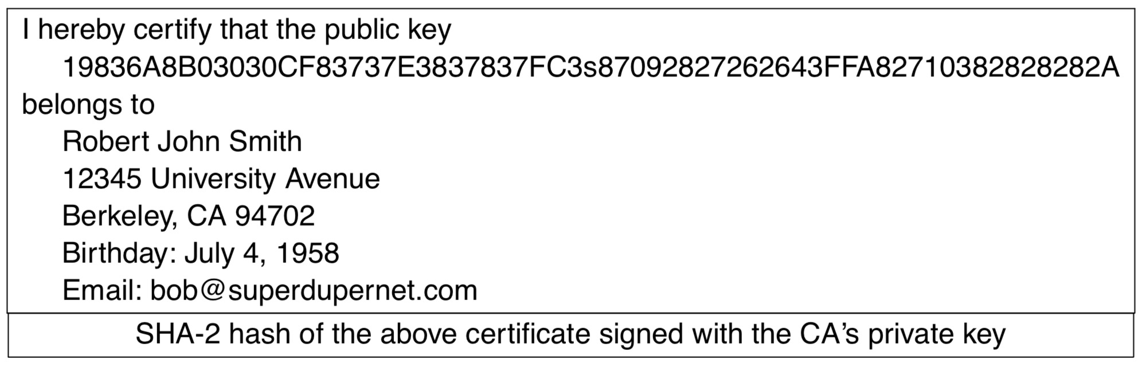
Certificates
A possible certificate and its signed hash

Slide 51
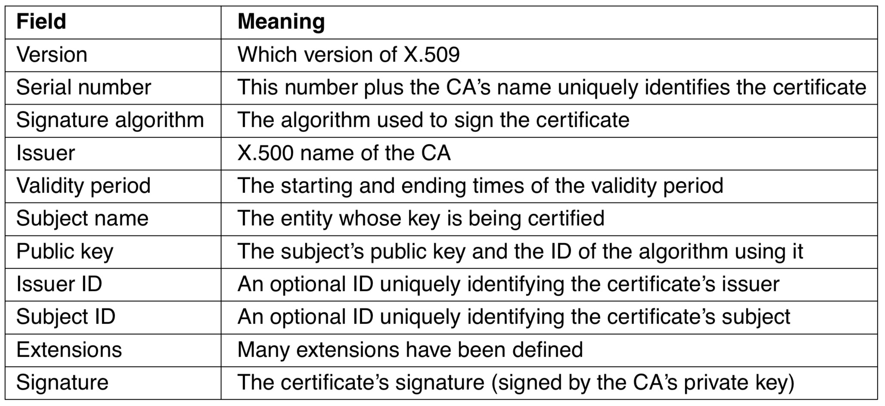
X.509
The basic fields of an X.509 certificate

Slide 52
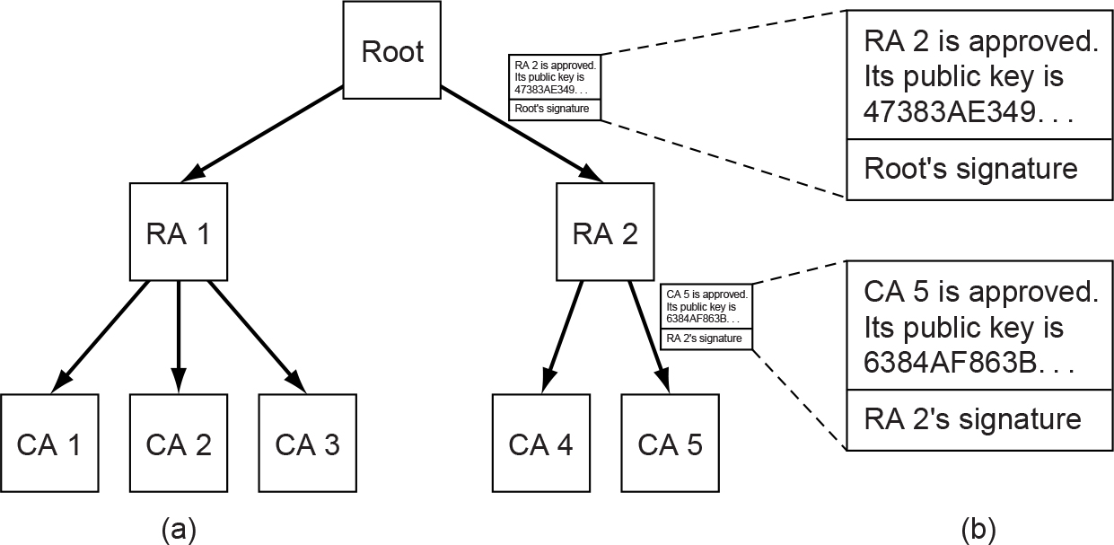
Public Key Infrastructures
(a) A hierarchical PKI. (b) A chain of certificates.

Slide 53
Authentication Protocols
Authentication based on a shared secret key
Establishing a shared key: the Diffie-Hellman key exchange
Authentication using a key distribution center
Authentication using Kerberos
Authentication using public-key cryptography

Slide 54
Authentication Based on a Shared Secret Key (1 of 7)
Notation for discussing protocols
A, B are the identities of Alice and Bob
R_{i}’s are the challenges, where i identifies the challenger
K_{i}’s are keys, where i indicates the owner
K_{S} is the session key

Slide 55
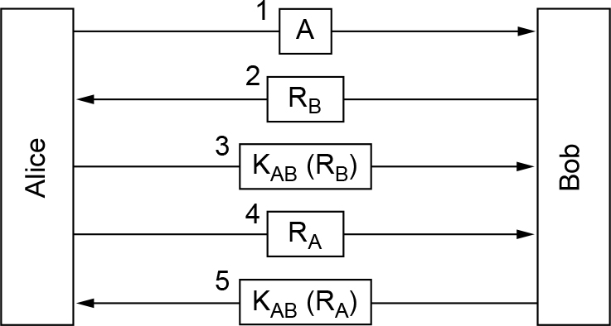
Authentication Based on a Shared Secret Key (2 of 7)
Two-way authentication using a challenge-response protocol

Slide 56
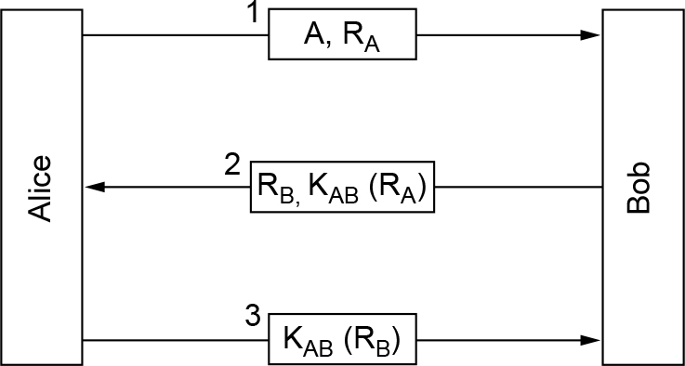
Authentication Based on a Shared Secret Key (3 of 7)
A shortened two-way authentication protocol

Slide 57
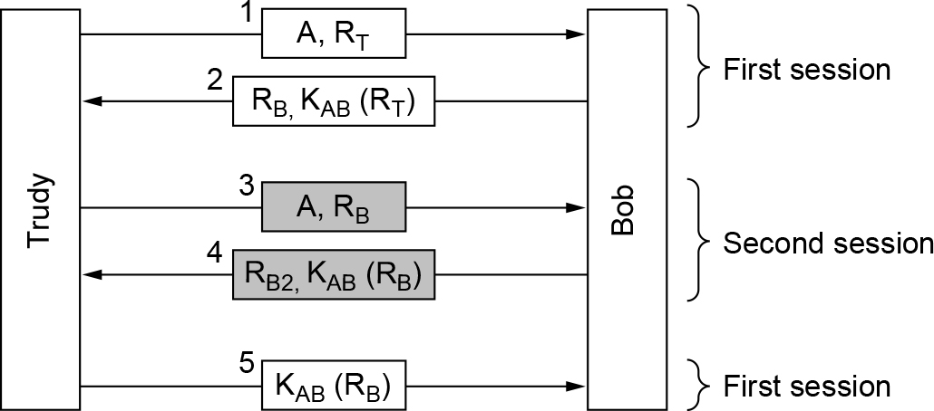
Authentication Based on a Shared Secret Key (4 of 7)
The reflection attack

Slide 58
Authentication Based on a Shared Secret Key (5 of 7)
General design rules
Have the initiator prove who she is before the responder has to
Have the initiator and responder use different keys for proof, even if this means having two shared keys, K_{AB} and K^{I}_{AB}
Have the initiator and responder draw their challenges from different sets
Make the protocol resistant to attacks involving a second parallel session in which information obtained in one session is used in a different one

Slide 59
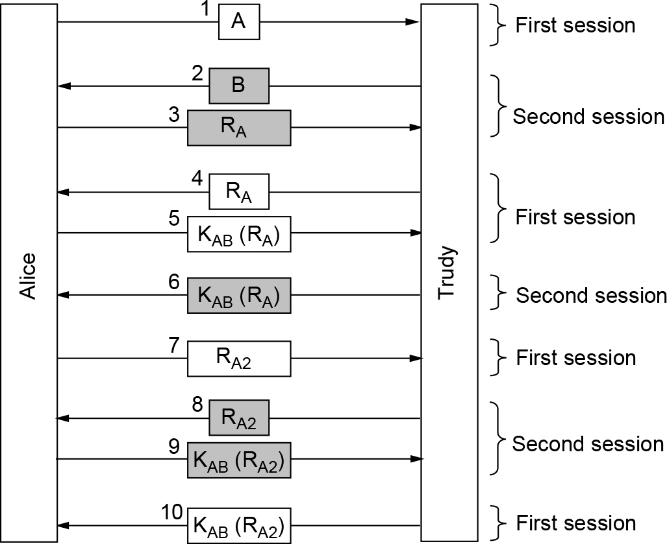
Authentication Based on a Shared Secret Key (6 of 7)
A reflection attack on the protocol of Fig. 8-29

Slide 60
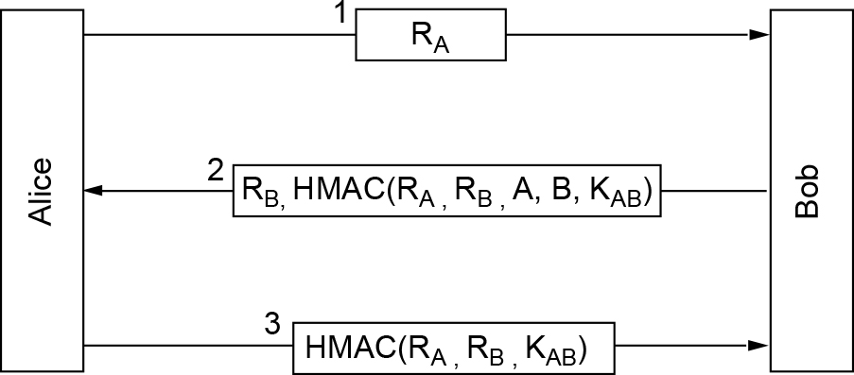
Authentication Based on a Shared Secret Key (7 of 7)
Authentication using HMACs

Slide 61
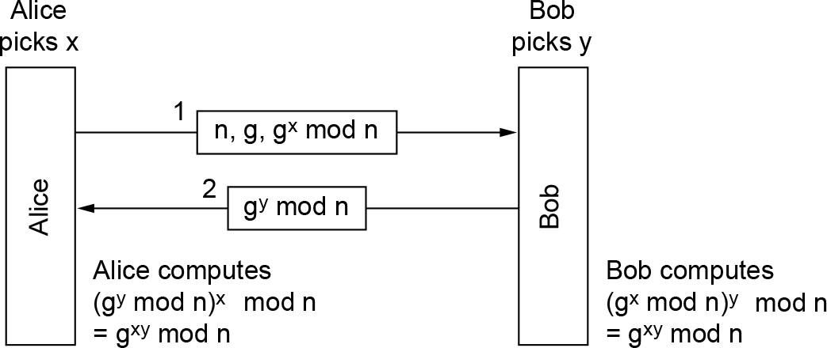
Establishing a Shared Key: The Diffie-Hellman Key Exchange (1 of 2)
The Diffie-Hellman key exchange

Slide 62
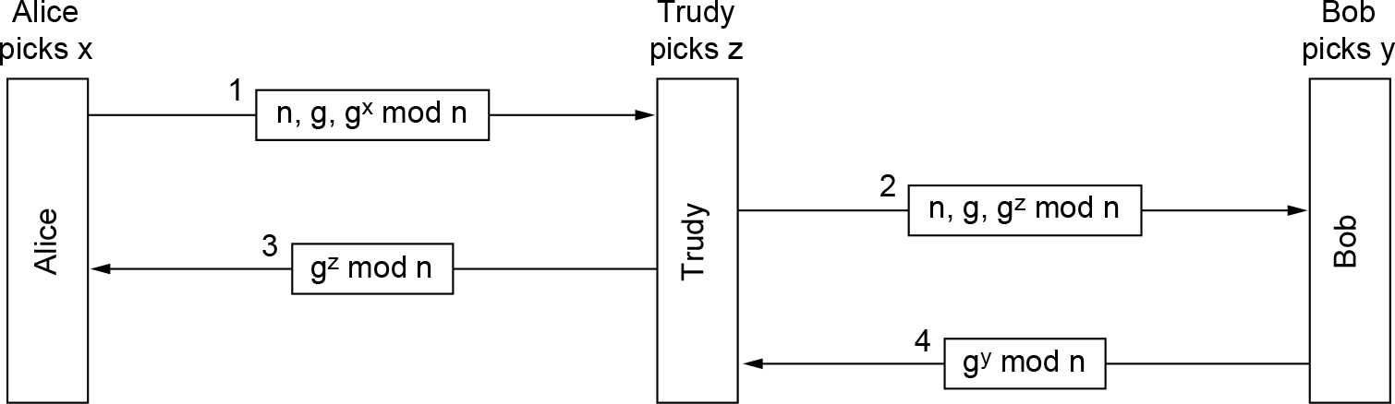
Establishing a Shared Key: The Diffie-Hellman Key Exchange (2 of 2)
The man-in-the-middle attack

Slide 63
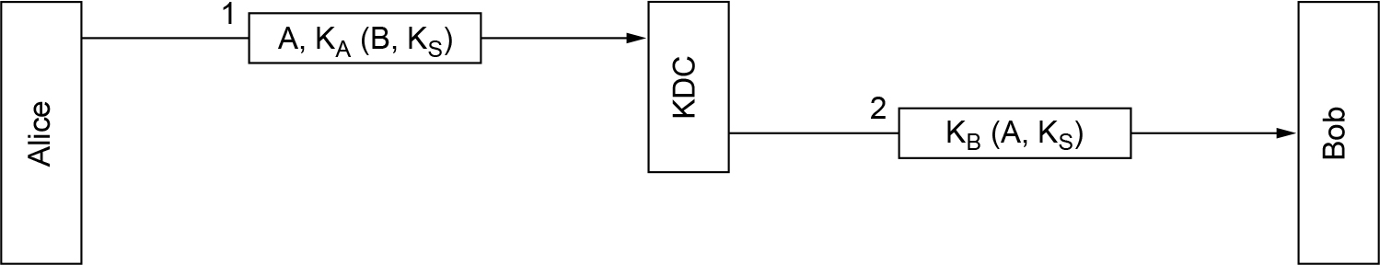
Authentication Using a Key Distribution Center (1 of 3)
A first attempt at an authentication protocol using a KDC

Slide 64
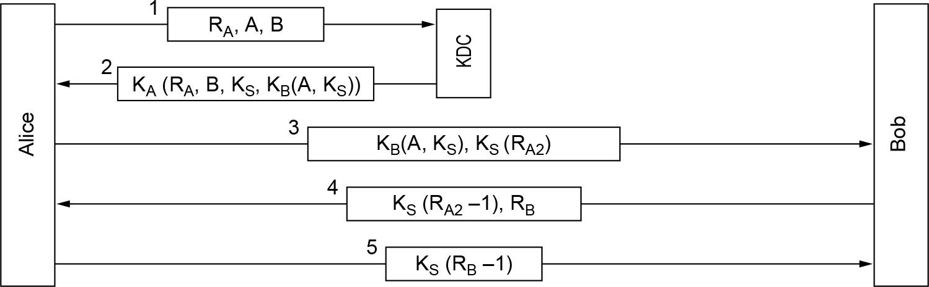
Authentication Using a Key Distribution Center (2 of 3)
The Needham-Schroeder authentication protocol

Slide 65
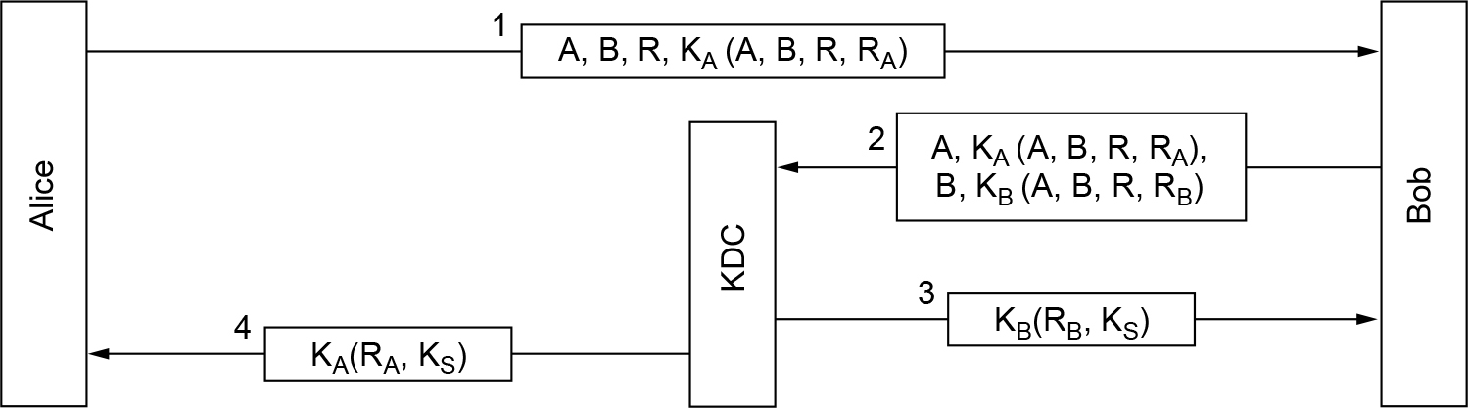
Authentication Using a Key Distribution Center (3 of 3)
The Otway-Rees authentication protocol (slightly simplified)

Slide 66
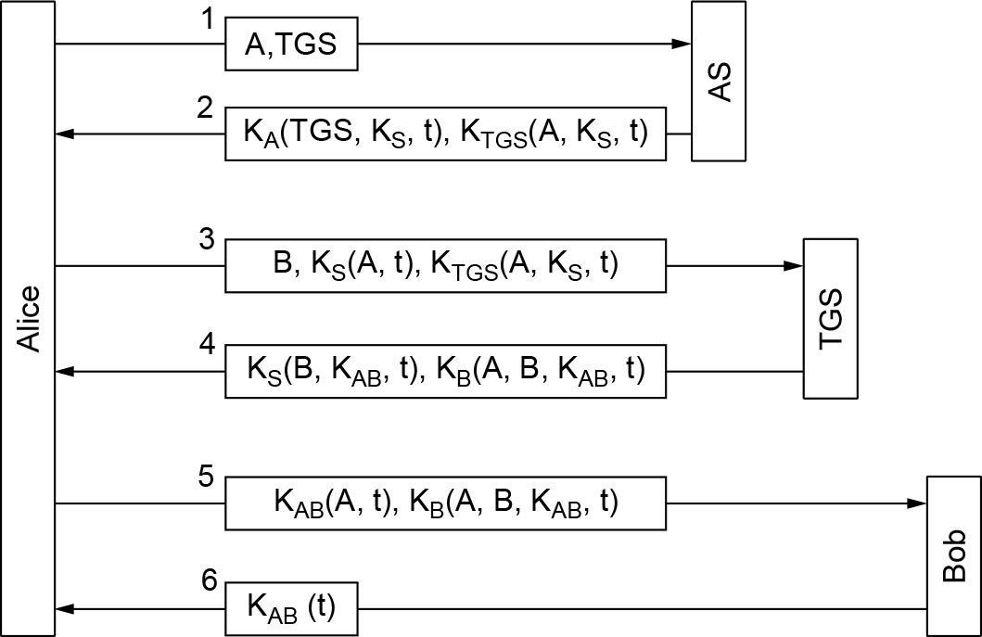
Authentication Using Kerberos
The operation of Kerberos V5

Slide 67
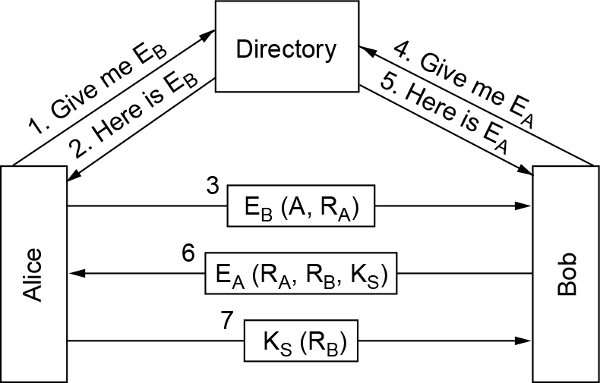
Authentication Using Public-Key Cryptography
Mutual authentication using public-key cryptography

Slide 68
Communication Security
IPsec
Virtual private networks
Wireless security

Slide 69
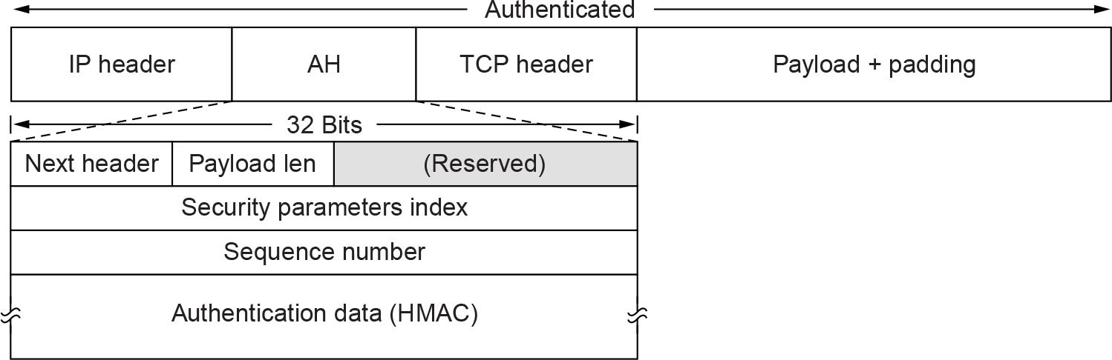
IPsec (1 of 2)
The IPsec authentication header in transport mode for IPv4

Slide 70
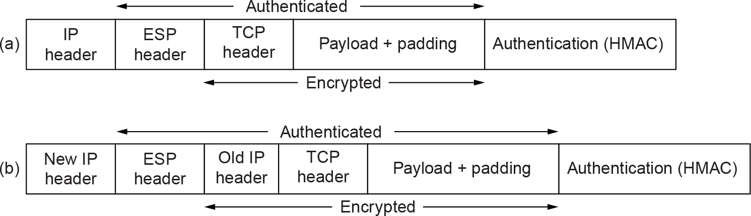
IPsec (2 of 2)
(a) ESP in transport mode. (b) ESP in tunnel mode.

Slide 71
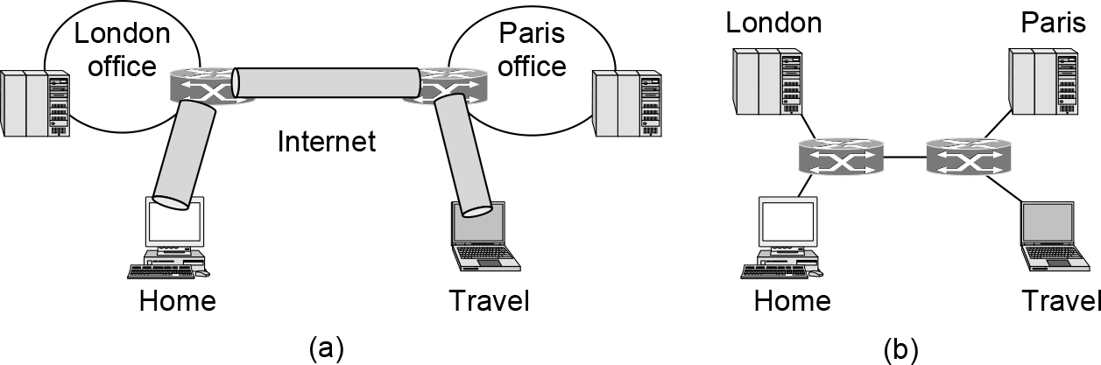
Virtual Private Networks
(a) A virtual private network. (b) Topology as seen from the inside

Slide 72
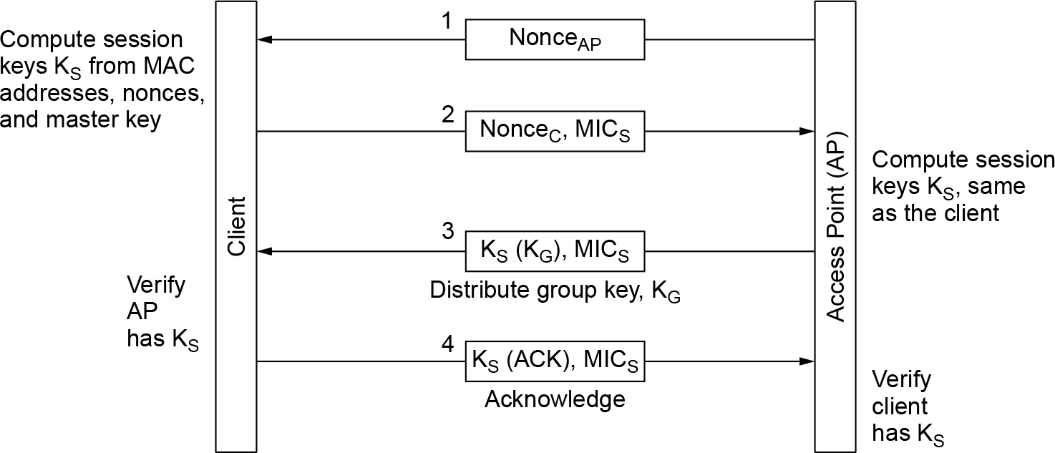
Wireless Security
The 802.11i key setup handshake

Slide 73
Email Security
Pretty Good Privacy
S/MIME

Slide 74
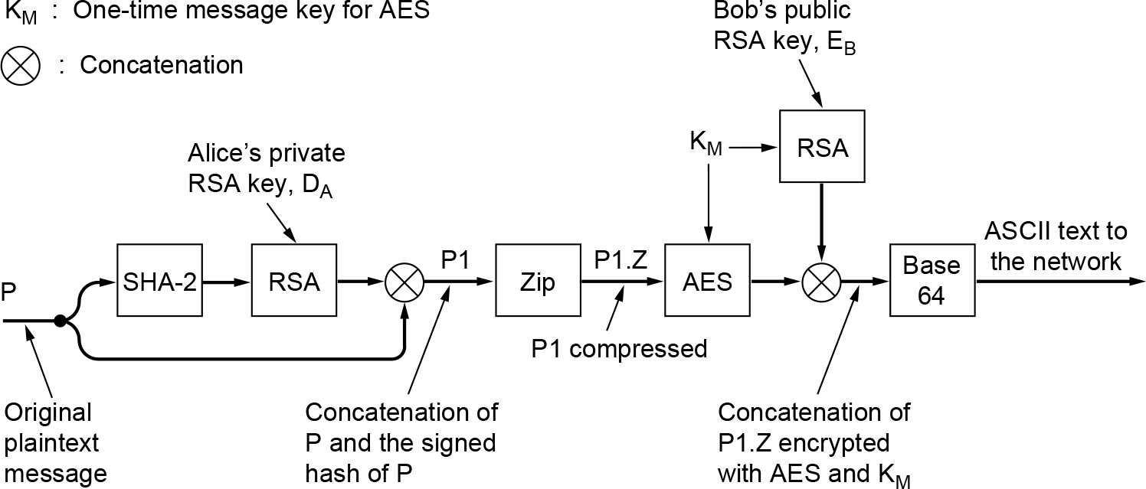
Pretty Good Privacy (1 of 3)
PGP in operation for sending a message

Slide 75
Pretty Good Privacy (2 of 3)
PGP supports multiple RSA key lengths
Regular user
Key length of 1024 bits may be sufficient
Government-funded three-letter organizations
Key length of 2048 bits should be the minimum
Aliens with sophisticated technology
Should use 4096 bit key option

Slide 76
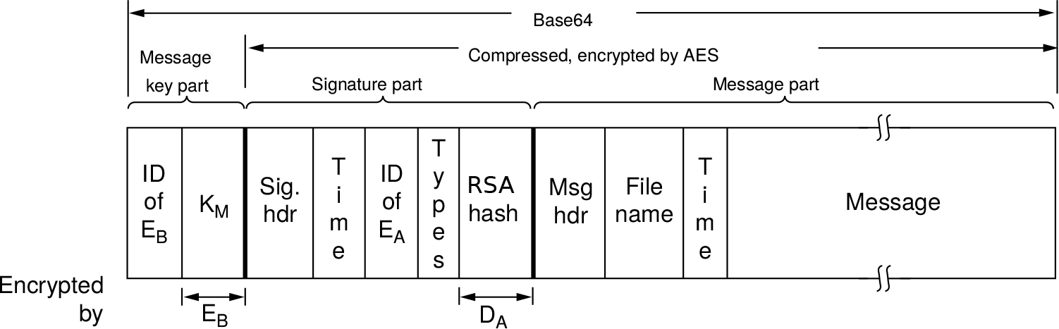
Pretty Good Privacy (3 of 3)
A PGP message

Slide 77
S/MIME
Secure/MIME
Described in RFC 2632 through RFC 2643
Provides authentication, data integrity, secrecy, and nonrepudiation
Supports a variety of cryptographic algorithms
Integrates well with MIME
Users can have multiple trust anchors
Uses standard algorithms and protocols

Slide 78
WEB Security
Threats
Secure naming and DNSSEC
Transport layer security
Running untrusted code

Slide 79
Secure Naming and DNSSEC (1 of 2)
DNSSEC’s three fundamental services:
Proof of where the data originated
Public key distribution
Transaction and request authentication

Slide 80
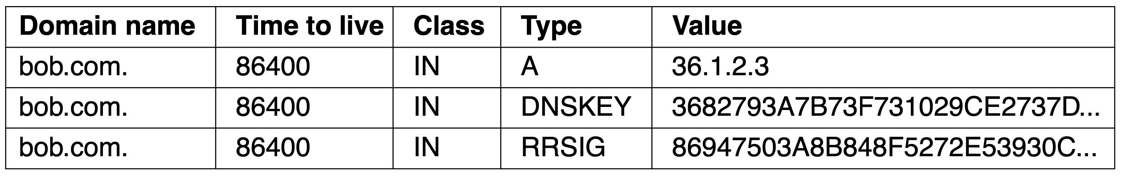
Secure Naming and DNSSEC (2 of 2)
An example RRSET for bob.com. The DNSKEY record is Bob’s public key. The RRSIG record is the top-level com server’s signed hash of the A and DNSKEY records to verify their authenticity.

Slide 81
Transport Layer Security (1 of 4)
Netscape introduced a security package called SSL (Secure Sockets Layer)
Now called TLS (Transport Layer Security)
SSL builds a secure connection between two sockets
Parameter negotiation between client and server
Authentication of the server by the client
Secret communication
Data integrity
HTTPS (Secure HTTP)
HTTP used over SSL
Sometimes available at a new port (443)

Slide 82
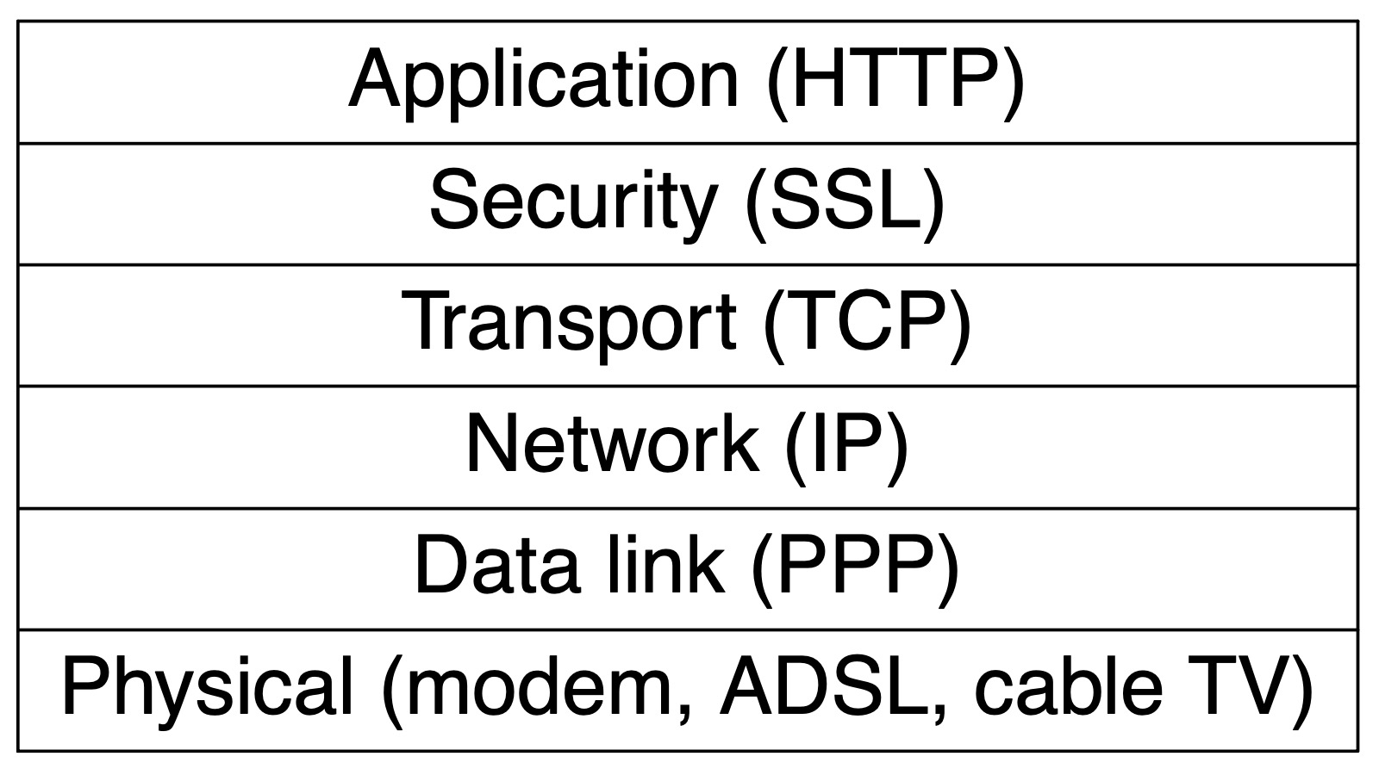
Transport Layer Security (2 of 4)
Layers (and protocols) for a home user browsing with SSL

Slide 83
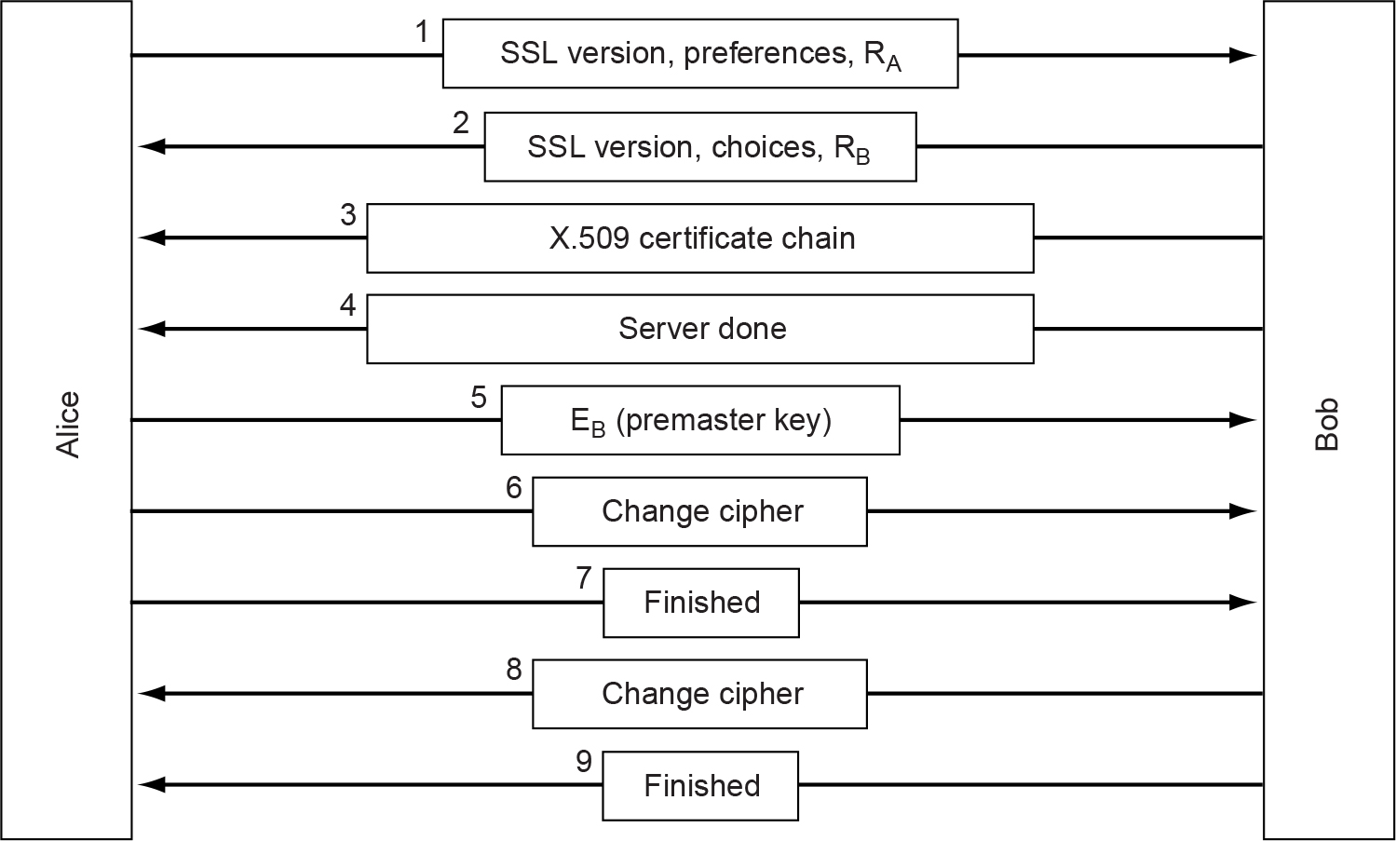
Transport Layer Security (3 of 4)
A simplified version of the SSL connection establishment subprotocol

Slide 84
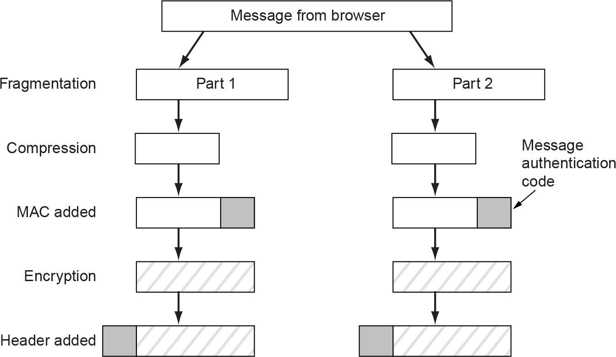
Transport Layer Security (4 of 4)
Data transmission using SSL

Slide 85
Running Untrusted Code
Scripting code in the browser
Browser extensions
Trojans and other malware

Slide 86
Social Issues
Confidential and anonymous communication
Freedom of speech
Copyright

Slide 87

Confidential and Anonymous Communication
How Alice uses three remailers to send Bob a message

Slide 88
Freedom of Speech (1 of 2)
Possible banned material
Material inappropriate for children or teenagers
Hate aimed at various ethnic, religious, sexual, or other groups
Information about democracy and democratic values
Accounts of historical events contradicting the government’s version
Manuals for picking locks, building nuclear weapons, encrypting messages, etc.

Slide 89

Freedom of Speech (2 of 2)
(a) Three zebras and a tree. (b) Three zebras, a tree, and the complete text of five plays by William Shakespeare.

Slide 90
Copyright Issues
Copyright
Grants Intellectual Property creators the exclusive right to their work
Typically lasts the life of the author plus 50 years
After copyright expires it passes into the public domain
DMCA gives content sellers more power
TCG (Trusted Computing Group)
Operates at a level below the operating system to prohibit unwanted behavior
TPM (Trusted Platform Module) chip

Slide 91

Copyright
This work is protected by United States copyright laws and is provided solely for the use of instructors in teaching their courses and assessing student learning. Dissemination or sale of any part of this work (including on the World Wide Web) will destroy the integrity of the work and is not permitted. The work and materials from it should never be made available to students except by instructors using the accompanying text in their classes. All recipients of this work are expected to abide by these restrictions and to honor the intended pedagogical purposes and the needs of other instructors who rely on these materials.

